Slide 1
Transformers, do we really need them for detecting stress?
Sven šćekić, Marko Kuzmić, Lovro Bučar

Slide 2
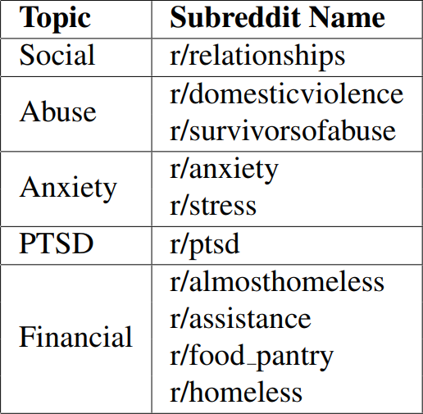
Dataset
Dreaddit
January 1st, 2017 – November 19th, 2018
186,444 posts in total

Slide 3
Data Annotation
Amazon Mechanical Turk
“Stress”, “Not Stress”, “Can’t Tell”
3,553 labeled segments
39% perfect agreement

Slide 4
Models
Logistic Regression
DistilBERT
Chat GPT 3.5 Turbo

Slide 5
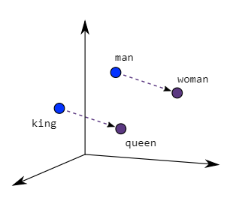
Logistic Regression
word2vec embeddings
Two approaches:
averaged embeddings
TF-IDF averaged embeddings

Slide 6
DistilBERT
Similar to BERT
More lightweight and faster

Slide 7
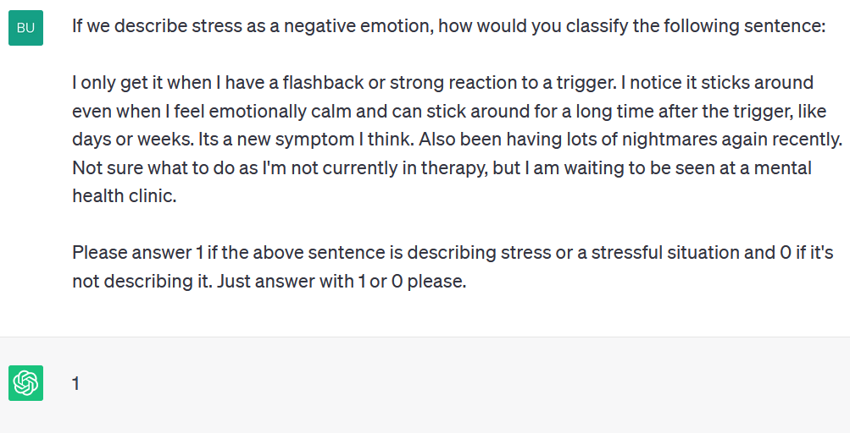
Chat GPT 3.5 Turbo
Developed by OpenAI
$0.002 per 1k tokens

Slide 8
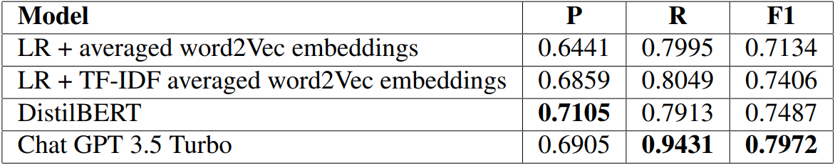
Results

